Slide 1

High Cloud Airlines Project
By group 6 (Excelr)
Shrilaxmi
Revati
Yash
Akshay
Ankan
Ganesh
Rushikesh
This Photo by Unknown Author is licensed under CC BY

Slide 2
TECHNOLOGIES USED
To perform the analysis and to get the insights via KPIs we’ve used Below Tools & Technologies.
MS EXCEL : For Data cleaning with precision and to create the base for the analysis.
My SQL : To get the accurate insights from the data.
Power BI : To create the modeling between the database, creating fluent data transmission and for creating the Interactive Graphs.
Tableau : We have used Tableau to create the responsive, User-friendly, informative Dashboards which shows the all the KPIs in a very fluent Manner.

Slide 3
OBJECTIVE
The High Cloud Airlines project aims to enhance the overall customer experience by delivering personalized services and seamless digital interactions, which will lead to increased passenger satisfaction. Additionally, the project focuses on boosting operational efficiency by optimizing flight operations, reducing delays, and improving on-time performance. Finally, the project seeks to increase revenue streams by diversifying income through ancillary services and strategic partnerships.

Slide 4
We have worked on this project to get the insights from the High Cloud Airlines Project.
Below Are the Main KPI’s which we have extracted from the shared data with us.
1.calcuate the following fields from the Year Month (#) Day fields ( First Create a Date Field from Year , Month , Day fields)
A. Year
B. Monthno
C. Monthfullname
D .Quarter(Q1,Q2,Q3,Q4)
E. YearMonth ( YYYY-MMM)
F. Weekdayno
G. Weekday name
H. Financial Month
I. Financial Quarter
2. Find the load Factor percentage on a yearly , Quarterly , Monthly basis ( Transported passengers / Available seats)
3. Find the load Factor percentage on a Carrier Name basis ( Transported passengers / Available seats)
4. Identify Top 10 Carrier Names based passengers preference
5. Display top Routes ( from-to City) based on Number of Flights
6. Identify the how much load factor is occupied on Weekend vs Weekdays.
7. Identify number of flights based on Distance group

Slide 5
1) Dates Wise Data
Year: Extract the year from the date. - Formula: YEAR([DateField])
Month Number: Get the numeric month (1-12). - Formula: MONTH([DateField])
Month Full Name: Return the full name of the month (e.g., January). - Formula: FORMAT([DateField], "MMMM") / TEXT(DateField, "MMMM")
Quarter: Get the quarter (Q1-Q4). - Formula: QUARTER([DateField])
YearMonth (YYYY-MMM): Combine year and abbreviated month (e.g., 2024-Jan). - Formula: FORMAT([DateField], "YYYY-MMM")
Weekday Number: Get the weekday number (1 for Sunday, etc.). - Formula: WEEKDAY([DateField])
Weekday Name: Return the full name of the weekday (e.g., Monday). - Formula: FORMAT([DateField], "dddd")
Financial Month: Adjust the month based on the financial year start. - Custom logic based on fiscal start month.
Financial Quarter: Adjust the quarter based on the financial year start.

Slide 6
Date Field | year | Month no. | Month name | Quarter | Year Month | Weekday no. | weekday Name | Finane Month | Quarter Month | Load factor
12/27/2008 | 2008 | 12 | December | Q4 | 2008 - December | 52 | Saturday | FM9 | FQ3 | 0.00
9/11/2008 | 2008 | 9 | September | Q3 | 2008 - September | 37 | Thursday | FM6 | FQ2 | 0.00
8/7/2008 | 2008 | 8 | August | Q3 | 2008 - August | 32 | Thursday | FM5 | FQ2 | 0.00
3/10/2008 | 2008 | 3 | March | Q1 | 2008 - March | 11 | Monday | FM12 | FQ4 | 0.00
8/3/2008 | 2008 | 8 | August | Q3 | 2008 - August | 32 | Sunday | FM5 | FQ2 | 0.00
7/14/2008 | 2008 | 7 | July | Q3 | 2008 - July | 29 | Monday | FM4 | FQ2 | 0.00
12/9/2008 | 2008 | 12 | December | Q4 | 2008 - December | 50 | Tuesday | FM9 | FQ3 | 0.00
2/28/2008 | 2008 | 2 | February | Q1 | 2008 - February | 9 | Thursday | FM11 | FQ4 | 0.00
10/5/2008 | 2008 | 10 | October | Q4 | 2008 - October | 41 | Sunday | FM7 | FQ3 | 0.00
3/17/2008 | 2008 | 3 | March | Q1 | 2008 - March | 12 | Monday | FM12 | FQ4 | 0.00
3/27/2008 | 2008 | 3 | March | Q1 | 2008 - March | 13 | Thursday | FM12 | FQ4 | 0.00
2/1/2008 | 2008 | 2 | February | Q1 | 2008 - February | 5 | Friday | FM11 | FQ4 | 0.00
5/18/2008 | 2008 | 5 | May | Q2 | 2008 - May | 21 | Sunday | FM2 | FQ1 | 0.00
3/24/2008 | 2008 | 3 | March | Q1 | 2008 - March | 13 | Monday | FM12 | FQ4 | 0.00
7/11/2008 | 2008 | 7 | July | Q3 | 2008 - July | 28 | Friday | FM4 | FQ2 | 0.00
10/8/2008 | 2008 | 10 | October | Q4 | 2008 - October | 41 | Wednesday | FM7 | FQ3 | 0.00
7/19/2008 | 2008 | 7 | July | Q3 | 2008 - July | 29 | Saturday | FM4 | FQ2 | 0.00
9/7/2008 | 2008 | 9 | September | Q3 | 2008 - September | 37 | Sunday | FM6 | FQ2 | 0.00

Slide 7
2) load Factor Percentage on a Yearly , Quarterly , Monthly basis
The chart provided is a line graph displaying the Year-wise Load Factor from 2008 to 2013, where each point represents the load factor percentage for a given year
Key Insights:-
2008: The load factor was 16.12%, marking the starting point of the graph.-
2009: There was a slight decrease to 15.94%, indicating a small decline in the load factor.-
2010: The load factor increased to 16.78%, showing a recovery
2011: The highest point in the graph, with a load factor of 17.19%
2012: A slight decline again to 16.85%
2013: The load factor slightly increased to 17.12%, almost reaching the peak from 2011
Overall Trend :
The general trend is an upward movement from 2009, with minor fluctuations in 2012. The load factor shows growth and improvement over the period, despite the dip in 2009 and 2012.This line graph helps in identifying yearly performance in terms of the load factor and makes it easier to analyze trends or deviations in the data over the years.

Slide 8
The image shows a line graph titled "Month-wise Load Factor" with percentages for each month. Here is the data extracted from the graph :-
January: 7.77%
February: 7.83%
March: 9.62%
April: 8.14%
May: 7.73%
June: 7.63%
July: 8.75%
August: 7.90%
September: 9.45%
October: 9.46%
November: 8.18%
December: 7.54%

Slide 9
The image shows a line graph representing the quarter-wise load factor percentages over four quarters (Q1 to Q4). Here's a visual explanation:1.
Q1: The load factor is 25.21%. This is the starting point on the graph.
Q2: The load factor decreases to 23.50%, indicating a drop from Q1.
Q3: The load factor increases to 26.11%, showing a rise from Q2 and reaching the highest point on the graph.4.
Q4: The load factor slightly decreases to 25.19%, ending just below the Q1 level.
The graph visually represents the fluctuations in the load factor across the four quarters, with a noticeable dip in Q2 and a peak in Q3.

Slide 10
3) Load Factor on Carrier Basis
The pie chart titled "Load Factor on Carrier Basis" visually represents the percentage of load factor attributed to different airlines. Each segment of the pie chart corresponds to a specific airline, with the size of the segment indicating the proportion of the total load factor.
Here's a breakdown of the load factors for each airline:- Allegiant Air: 5%
American Eagle Airlines Inc.: 7%
Atlantic Southeast Airlines: 5%
Comair Inc.: 6%
Continental Air Lines Inc.: 11%
Delta Air Lines Inc.: 20%
ExpressJet Airlines Inc.: 6%
SkyWest Airlines Inc.: 10%
Southwest Airlines Co.: 19%
US Airways Inc.: 11%
The largest segment is for Delta Air Lines Inc. at 20%, indicating it has the highest load factor among the listed carriers. Southwest Airlines Co. follows with 19%. The smallest segments are for Allegiant Air and Atlantic Southeast Airlines, each with 5%.

Slide 11
4) Top 10 Carriers based on Passengers Preference
The Bar chart titled “Top 10 carriers based on passengers preference" visually represents the Top 10 Carriers Names on the basis of Passengers Preference
Here is below information
American Eagle Airlines Inc. | 3312
Continental Air Lines Inc. | 4613
Delta Air Lines Inc. | 8271
ExpressJet Airlines Inc. (1) | 2884
Federal Express Corporation | 5628
Hageland Aviation Service | 4646
SkyWest Airlines Inc. | 4201
Southwest Airlines Co. | 8019
United Parcel Service | 2753
US Airways Inc. | 4288

Slide 12
5) Top Routes ( from-to City) based on Number of Flights
The bar chart displays the top routes based on the number of flights. Here's a breakdown of the data:
1. Chicago, IL - Detroit, MI: 95 flights
2. Washington, DC - New York, NY: 88 flights
3. Washington, DC - Atlanta, GA: 86 flights
4. Charlotte, NC - Atlanta, GA: 83 flights
5. Chicago, IL - Atlanta, GA: 82 flights
The route with the highest number of flights is Chicago, IL to Detroit, MI, while the route with the lowest number of flights among these is Chicago, IL to Atlanta, GA.

Slide 13
6)Load factor On Weekends & Weekday
The pie chart visually represents the load factor distribution between weekdays and weekends. Here's a breakdown:
Weekday Load Factor: Represented by the blue section, which accounts for 71% of the total load factor.
Weekend Load Factor: Represented by the orange section, which accounts for 29% of the total load factor.
This visual explanation shows that the load factor is significantly higher on weekdays compared to weekends.

Slide 14
7) Number Of Flights Based On Distance Group
Distance Group ID | Count of Airline ID
1 | 58047
2 | 28131
3 | 11333
4 | 6092
5 | 2330
6 | 855
7 | 612
8 | 1082
9 | 810
10 | 524
11 | 419
12 | 145
13 | 83
14 | 174
15 | 117
16 | 58
17 | 32
18 | 4
21 | 1

Slide 15
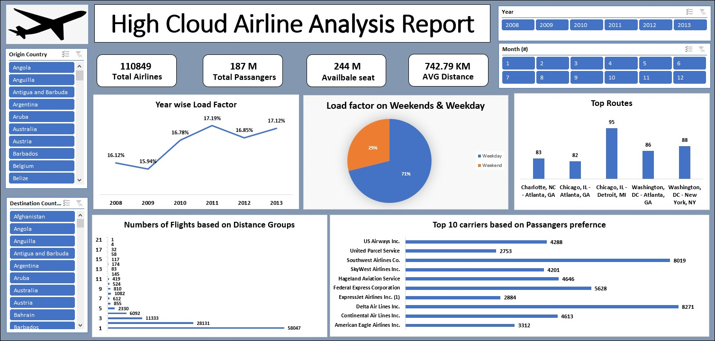
MS Excel Dashboard

Slide 16
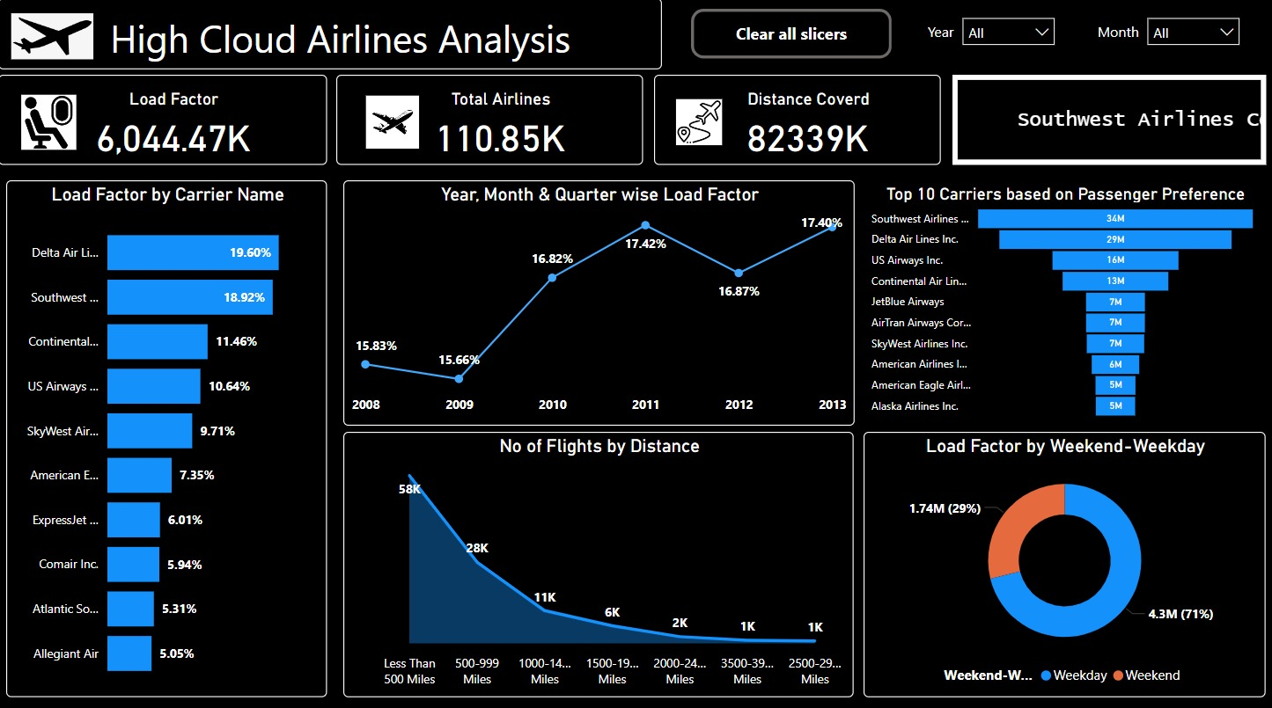
Power Bi Dashboard

Slide 17
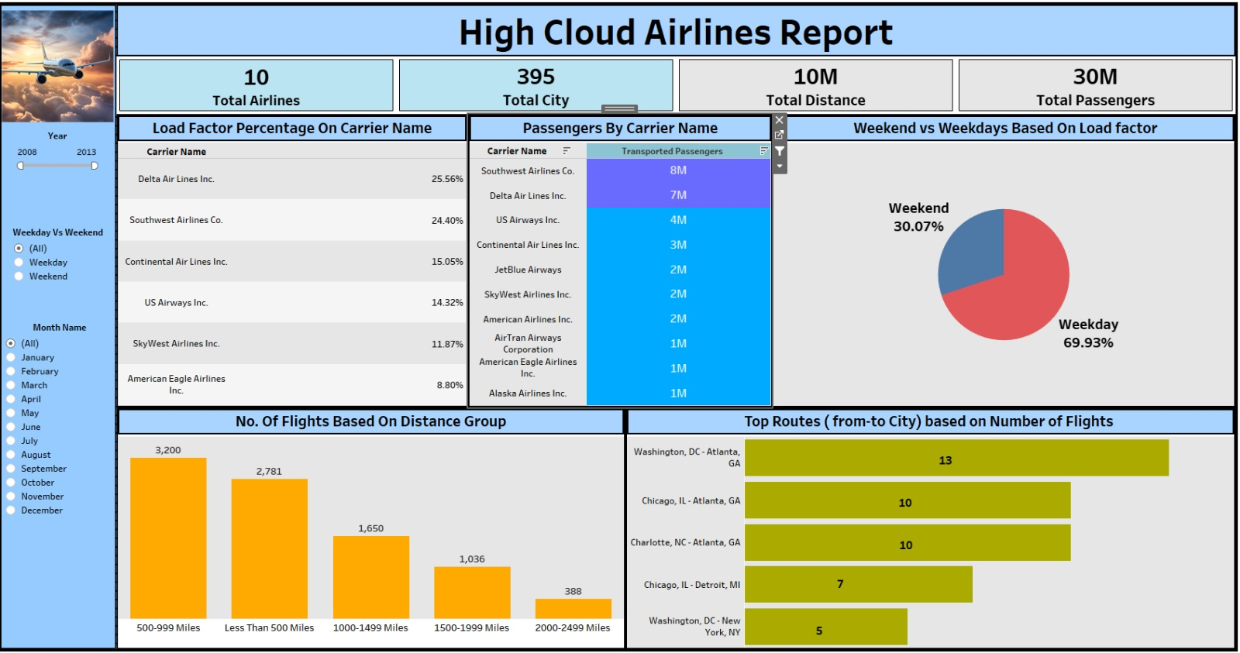
Tableau Dashboard

Slide 18
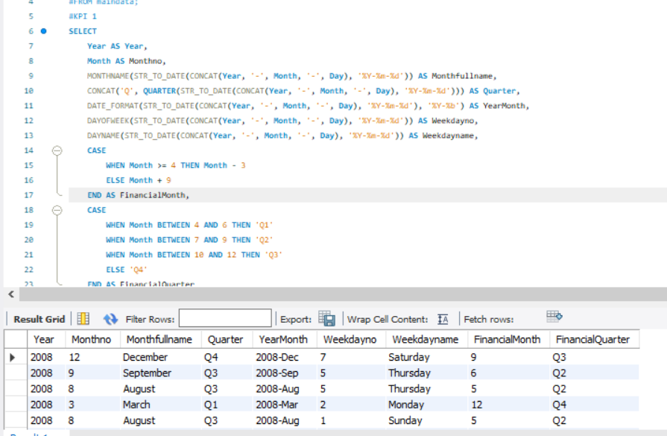
SQL Quaries & Output
1) Dates Wise Data -

Slide 19
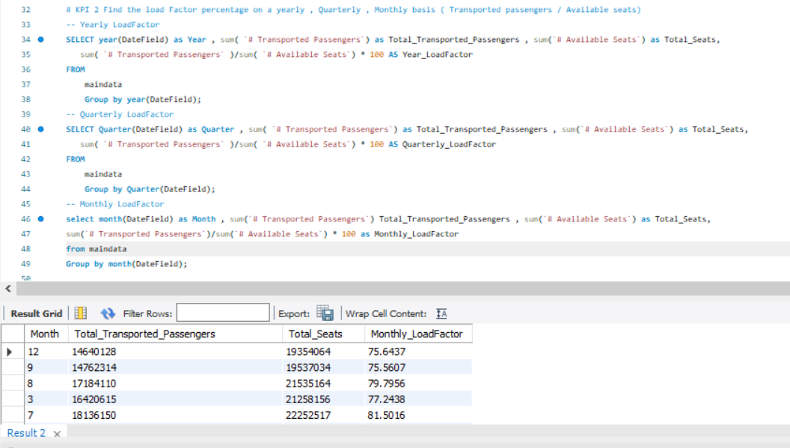
2) load Factor Percentage on a Yearly , Quarterly , Monthly basis -

Slide 20
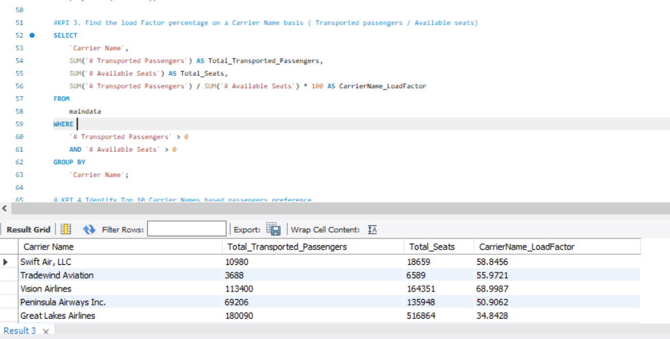
3) Load Factor on Carrier Basis -

Slide 21
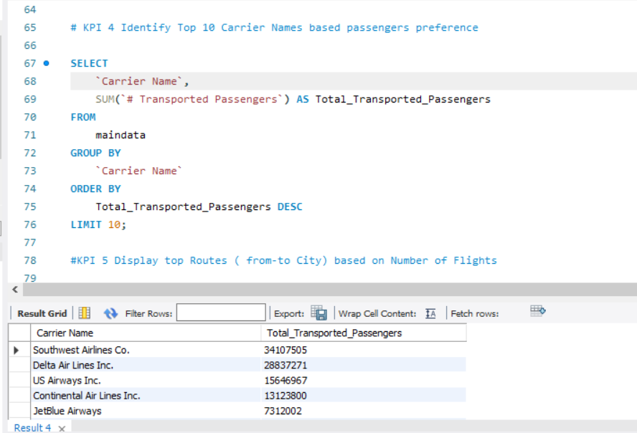
4) Top 10 Carriers based on Passengers Preference -

Slide 22
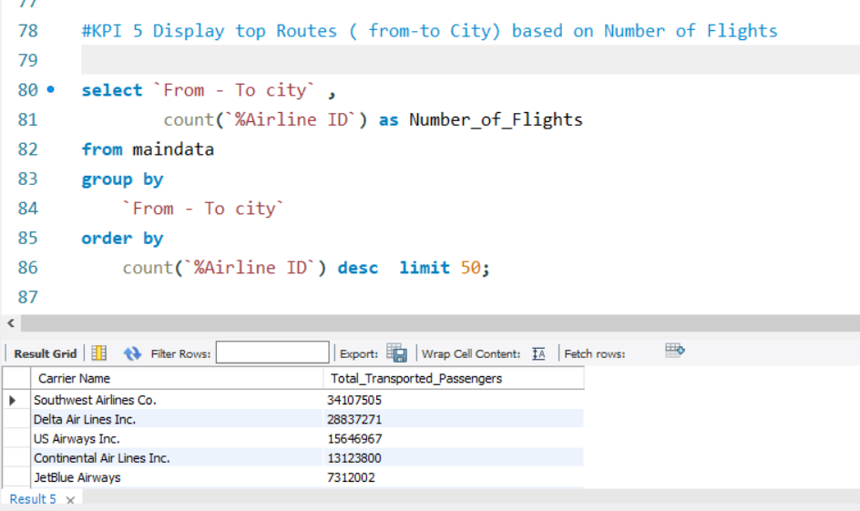
5) Top Routes ( from-to City) based on Number of Flights -

Slide 23
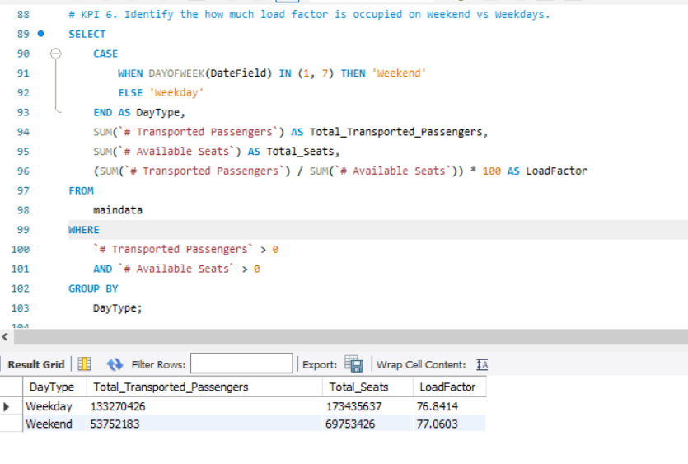
6)Load factor On Weekends & Weekday -

Slide 24
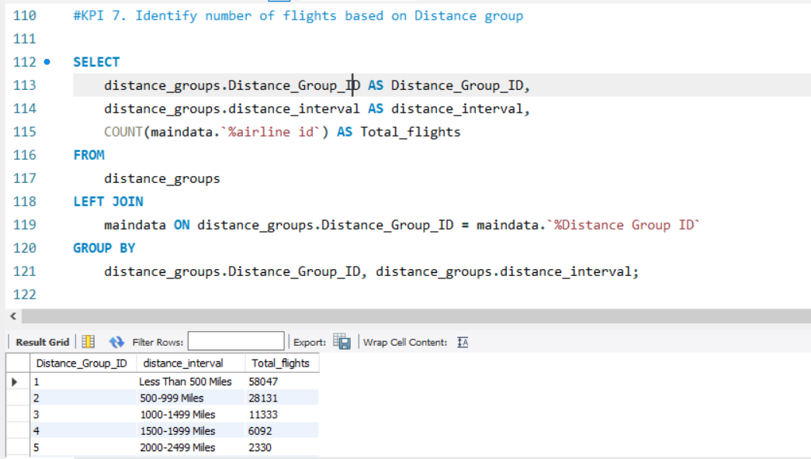
7) Number Of Flights Based On Distance Group -

Slide 25
Thank You

